Slide 1
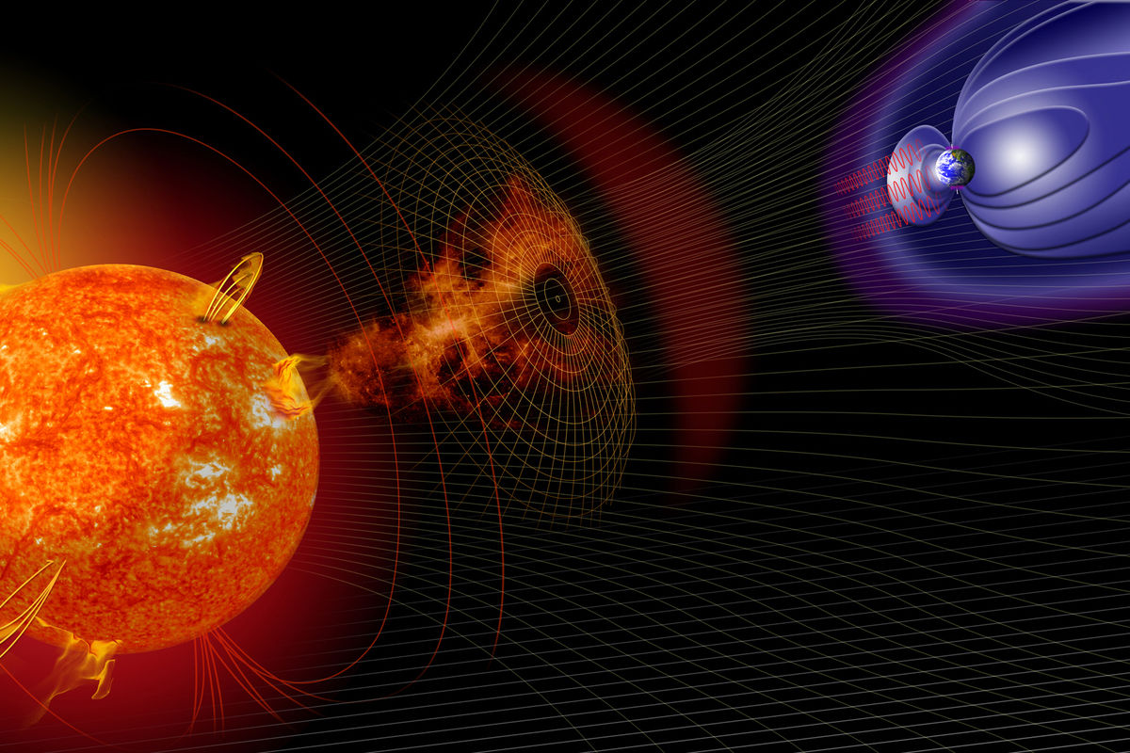
Forecasting Disturbance Storm-Time Index
Time Series Analysis
By: Ritika Shrivastava

Slide 2
Introduction
The aim of this project is to develop model for forecasting Dst (Disturbance Storm-Time Index) that 1) push the boundary of predictive performance 2) under operationally viable constraints 3) using specified real-time solar-wind data feeds.
The goal is to predict the Disturbance Storm-Time Index (Dst), a measure of magnetic activity, from the provided data up to the time of prediction.
Dst values are measured by 4 ground-based observatories near the equator. These values are then averaged to provide a measurement of Dst for any given hour. However, these values are not always provided in a timely manner.

Slide 3
Dataset
bx_gse - Interplanetary-magnetic-field (IMF) X-component in geocentric solar ecliptic (GSE) coordinate (nanotesla (nT))
by_gse - Interplanetary-magnetic-field Y-component in GSE coordinate (nT)
bz_gse - Interplanetary-magnetic-field Z-component in GSE coordinate (nT)
theta_gse - Interplanetary-magnetic-field latitude in GSE coordinates (defined as the angle between the magnetic vector B and the ecliptic plane, being positive when B points North) (degrees)
phi_gse - Interplanetary-magnetic-field longitude in GSE coordinates (the angle between the projection of the IMF vector on the ecliptic and the Earth–Sun direction) (degrees)
bx_gsm - Interplanetary-magnetic-field X-component in geocentric solar magnetospheric (GSM) coordinate (nT)
by_gsm - Interplanetary-magnetic-field Y-component in GSM coordinate (nT)
bz_gsm - Interplanetary-magnetic-field Z-component in (GSM) coordinate (nT)
theta_gsm - Interplanetary-magnetic-field latitude in GSM coordinates (degrees)
phi_gsm - Interplanetary-magnetic-field longitude in GSM coordinates (degrees)
bt - Interplanetary-magnetic-field component magnitude (nT)
density - Solar wind proton density (N/cm^3)
speed - Solar wind bulk speed (km/s)
temperature - Solar wind ion temperature (Kelvin)

Slide 4
Hypothesis to test
Target variable dst follows a seasonal trend over the years.
Target variable dst is influenced by the lagged values of features associated with the solar winds.
Target variable dst depends on the previous day’s dst.

Slide 5
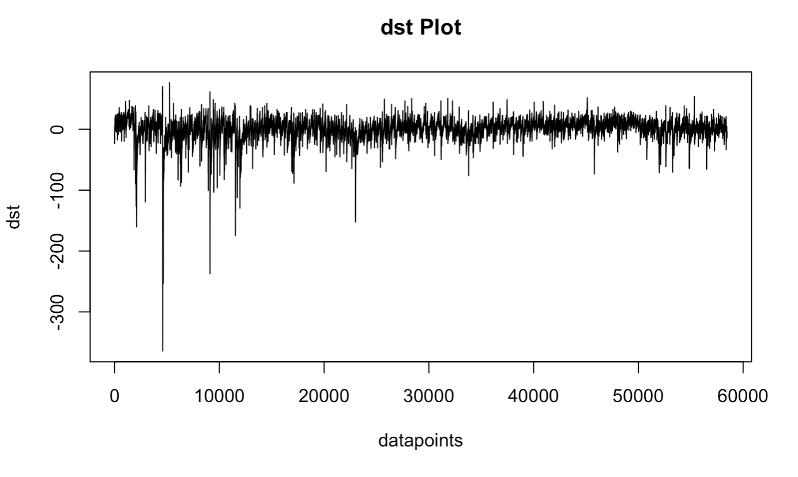
Dst (Target Variable) Time Series Plot
The plot shows volatility in the data, with many spikes particularly evident in the negative direction. The range of the 'dst' values on the y-axis goes from 67 to -374.
The distribution of spikes does not seem to follow a regular pattern, indicating that there is no clear periodicity based solely on this graph. The data points look more like "noise," as we do not see a clear trend upwards or downwards, nor do we see a repeating pattern. Since dst is a geomagnetic disturbance, the variability could suggest the presence of random or chaotic events affecting the readings.

Slide 6
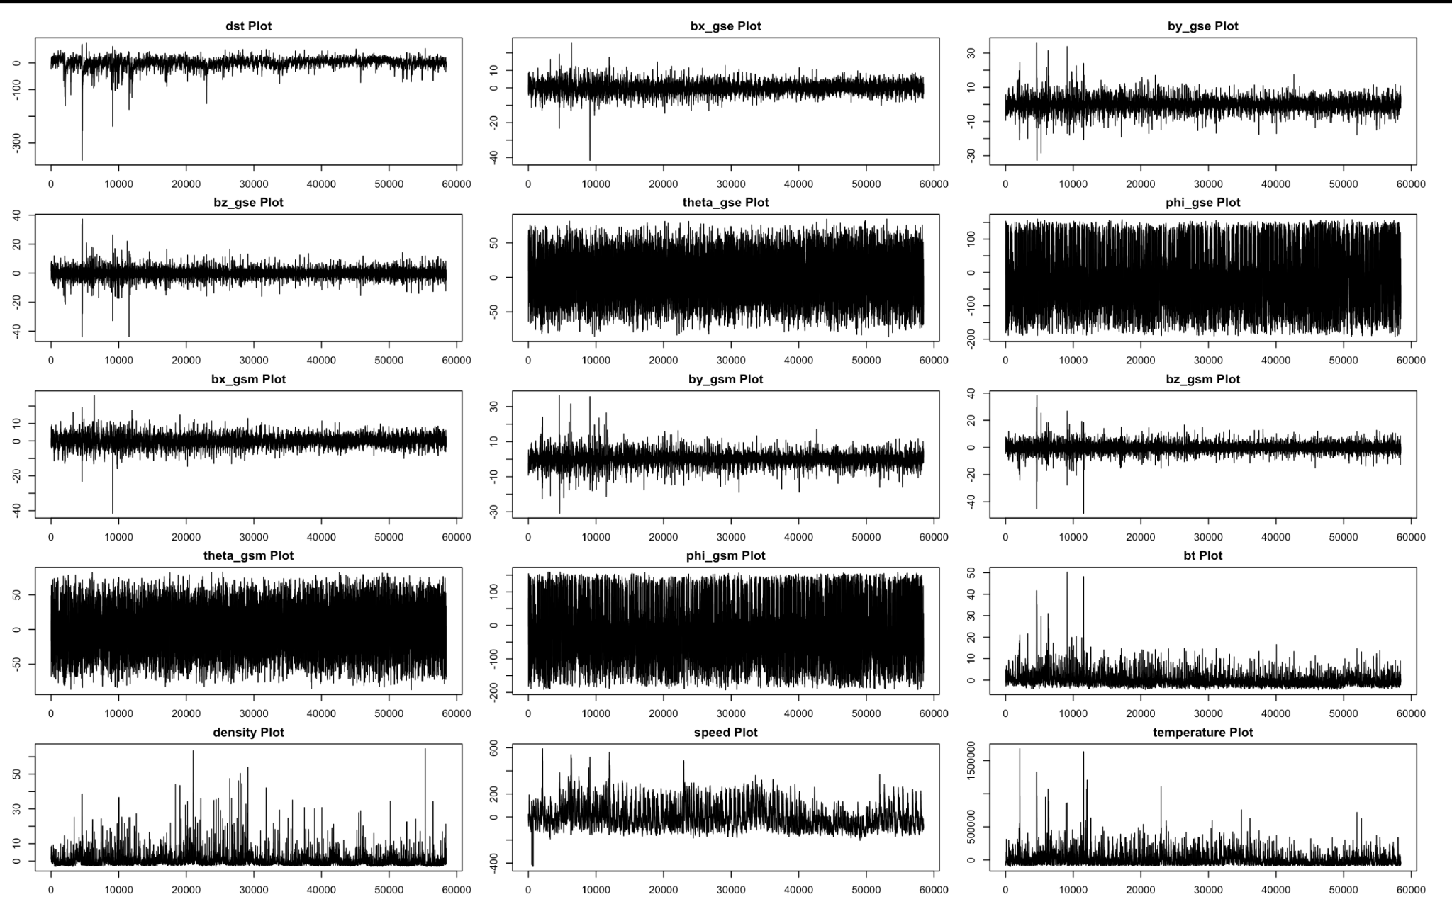
Features Time Series Plot

Slide 7
Features Time Series Plot Summary
bx_gse Plot: The x-component of the magnetic field in geocentric solar ecliptic (GSE) coordinates, which appears fairly stable.
by_gse Plot: The y-component in GSE coordinates, showing some variability.
bz_gse Plot: The z-component in GSE coordinates, also displaying variability that could be associated with solar wind changes.
theta_gse Plot: The polar angle in GSE coordinates, showing a dense and highly variable dataset.
phi_gse Plot: The azimuthal angle in GSE coordinates, with a high-density plot indicating rapid changes or a large range of values.
bx_gsm Plot: The x-component of the magnetic field in geocentric solar magnetospheric (GSM) coordinates, which appears stable similar to the GSE equivalent.
by_gsm Plot: The y-component in GSM coordinates, showing variability.
bz_gsm Plot: The z-component in GSM coordinates, displaying a pattern that may be indicative of consistent fluctuations or cyclic behavior.
theta_gsm Plot: The polar angle in GSM coordinates, with significant variability and dense plotting.
phi_gsm Plot: The azimuthal angle in GSM coordinates, displaying a wide range of values with dense plotting.
bt Plot: The total magnetic field strength, with spikes that might correspond to solar events or interplanetary shocks.
density Plot: The plasma density, which has large spikes potentially indicating solar flare events or coronal mass ejections.
speed Plot: The solar wind speed, showing variability and some prominent peaks, possibly from high-speed streams emanating from coronal holes.
temperature Plot: The solar wind temperature, with extreme values in some instances which could correlate with solar activity.

Slide 8
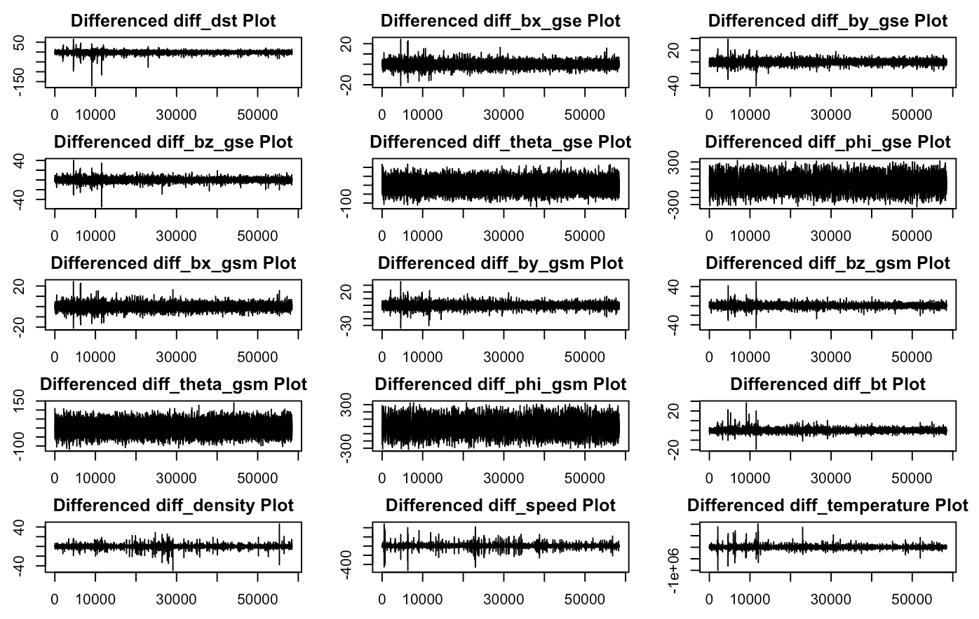
Features Time Series Plot after Differencing

Slide 9
Features Time Series Plot Summary after Differencing
Differenced dst: The changes in the dst variable appear to fluctuate around zero without a discernible pattern or trend, which is typical after differencing a time series that has a trend.
Differenced bx_gse, by_gse, and bz_gse: The magnetic field components in GSE coordinates (bx_gse, by_gse, bz_gse) show variability around zero, similar to dst. This indicates that the differencing may have removed any linear trend, and the resulting series is mean stationary.
Differenced theta_gse and phi_gse: Both angular measurements in GSE coordinates (theta_gse and phi_gse) exhibit high-frequency fluctuations after differencing, with no visible trend, which is consistent with a differenced stationary process.
Differenced bx_gsm, by_gsm, and bz_gsm: For the GSM coordinates, the magnetic field components also show variations around zero. This suggests that these series also have no strong trends after differencing.
Differenced theta_gsm and phi_gsm: The differenced angular measurements in GSM coordinates are similar to their GSE counterparts, with a lot of variability but no clear trend, indicating a mean stationary process.
Differenced bt: The total magnetic field strength (bt) exhibits a similar pattern to the other magnetic field components, with no apparent trend after differencing.
Differenced density: Plasma density changes are scattered around zero, but with some larger spikes, suggesting occasional larger changes from one measurement to the next.
Differenced speed: Solar wind speed changes show a similar pattern to density, with some outliers that may indicate large changes or events.
Differenced temperature: The temperature of the solar wind shows the most pronounced spikes after differencing, indicating significant variability and occasional large shifts from one time point to another.

Slide 10
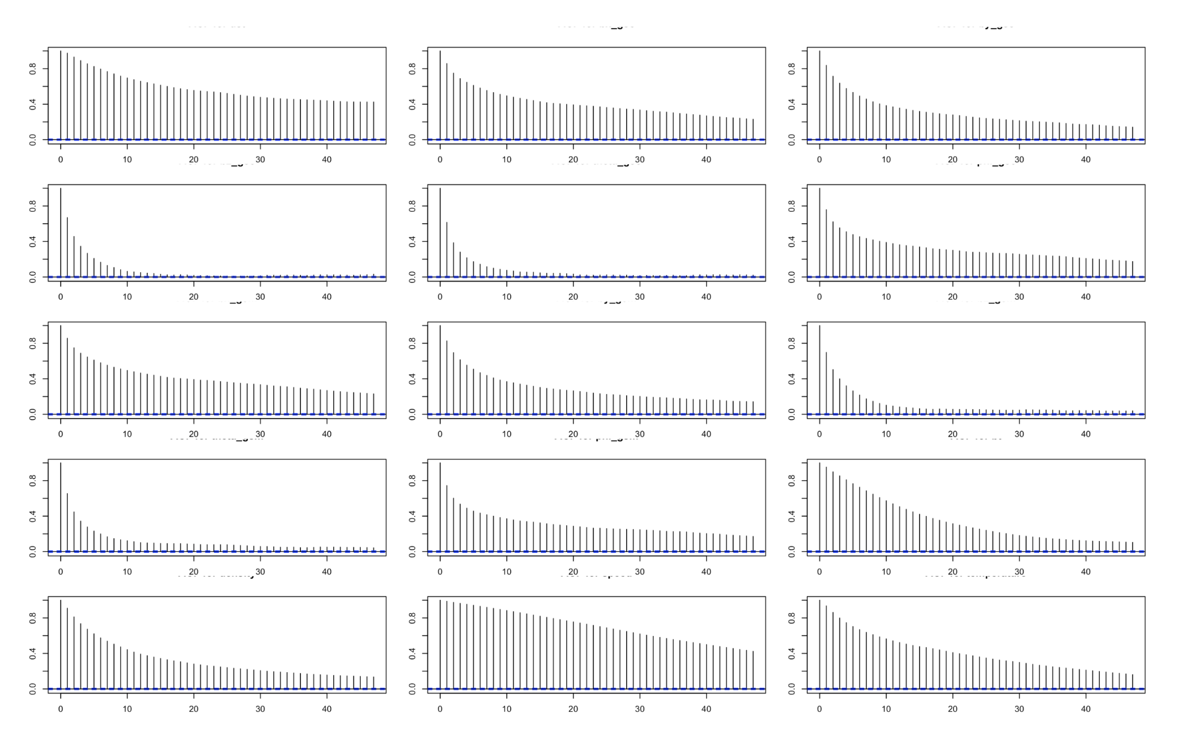
Autocorrelation Plots

Slide 11
Autocorrelation Plots Summary
dst: Shows strong positive autocorrelation at lag 0 (as expected, since it's the correlation with itself), which decreases gradually but remains positive for all observed lags. This suggests a slowly decaying correlation over time, which is typical of a process with persistent memory.
bx_gse: Exhibits strong initial autocorrelation that drops off quickly. This might indicate a process with some degree of short-term predictability but little long-term correlation.
by_gse: Similar to bx_gse, it has a quick drop-off in autocorrelation. This behavior also indicates short-term predictability.
bz_gse: Shows a gradual decrease in autocorrelation, not as sharp as bx_gse or by_gse, suggesting some medium-term correlations.
theta_gse: Features an immediate and steep decline in autocorrelation, signifying that the values are less predictable from one time point to the next.
phi_gse: This plot, much like theta_gse, shows a sharp drop in autocorrelation, indicating limited predictability from one observation to the next.
bx_gsm: Displays a profile of autocorrelation similar to bx_gse, with a steep initial decline.
by_gsm: The autocorrelation decreases slightly but seems to stabilize, indicating some degree of short to medium-term predictability.
bz_gsm: Presents a slow decrease in autocorrelation, suggesting persistent effects over time.
theta_gsm: Shows a steep decline in autocorrelation, suggesting that the variable is less autocorrelated over time.
phi_gsm: Similar to theta_gsm, phi_gsm has a sharp drop, indicating low predictability over time.
bt: Autocorrelation decreases gradually, which indicates some long-term influence or trend.
density: Shows strong autocorrelation that decays gradually, suggesting a slowly changing process with persistent effects.
speed: Features a quick drop in autocorrelation, indicating short-term predictability and less correlation as the lag increases.
temperature: This plot shows a steep decline in autocorrelation, similar to speed, which suggests that temperature at one point is not a strong predictor of future values as time progresses.

Slide 12
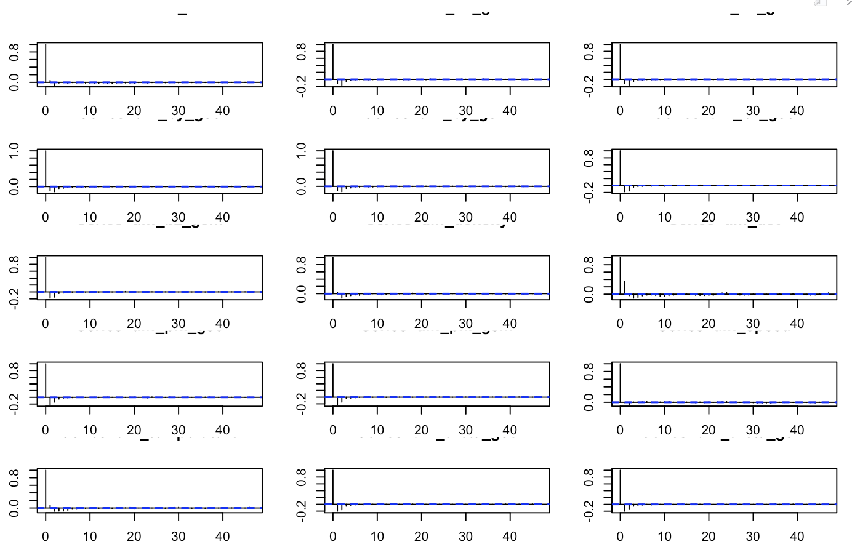
Autocorrelation Plots after Differencing

Slide 13
Autocorrelation Plots Summary after Differencing
acf(diff_bt): The ACF plot for the differenced total magnetic field strength shows autocorrelations near zero across all lags, indicating no significant autocorrelation.
acf(diff_bx_gse): This ACF plot for the differenced x-component of the magnetic field in GSE coordinates also shows autocorrelations close to zero, suggesting no significant autocorrelation at the lags represented.
acf(diff_bx_gsm): The ACF plot for the differenced x-component in GSM coordinates mirrors the previous ones, with all values within the confidence interval and no significant autocorrelation.
acf(diff_by_gse): The ACF for the differenced y-component of the magnetic field in GSE coordinates shows a similar pattern, with no lag showing significant autocorrelation.
acf(diff_by_gsm): For the differenced y-component in GSM coordinates, the ACF plot indicates no significant autocorrelation at any lags.
acf(diff_bz_gse): The differenced z-component in GSE coordinates has an ACF plot without significant autocorrelation at any of the lags displayed.
acf(diff_bz_gsm): Similarly, the ACF plot for the differenced z-component in GSM coordinates shows autocorrelation values remaining within the confidence bounds.
acf(diff_density): The plot for the differenced plasma density displays autocorrelations close to zero across all lags.
acf(diff_dst): The disturbance storm time index's differenced values show no significant autocorrelation in the ACF plot.
acf(diff_phi_gse): For the differenced azimuthal angle in GSE coordinates, the ACF plot indicates no significant autocorrelation at the lags represented.
acf(diff_phi_gsm): The ACF plot for the differenced azimuthal angle in GSM coordinates similarly shows a lack of significant autocorrelation.
acf(diff_speed): The plot for the differenced solar wind speed has autocorrelation values that remain within the bounds, indicating no significant autocorrelation.
acf(diff_temperature): For the differenced solar wind temperature, the ACF plot also shows autocorrelation values within the confidence interval, with no significant autocorrelation detected.
acf(diff_theta_gse): The plot for the differenced polar angle in GSE coordinates follows the pattern of no significant autocorrelation at any lag.
acf(diff_theta_gsm): Lastly, the differenced polar angle in GSM coordinates shows an ACF plot with no significant autocorrelation.

Slide 14
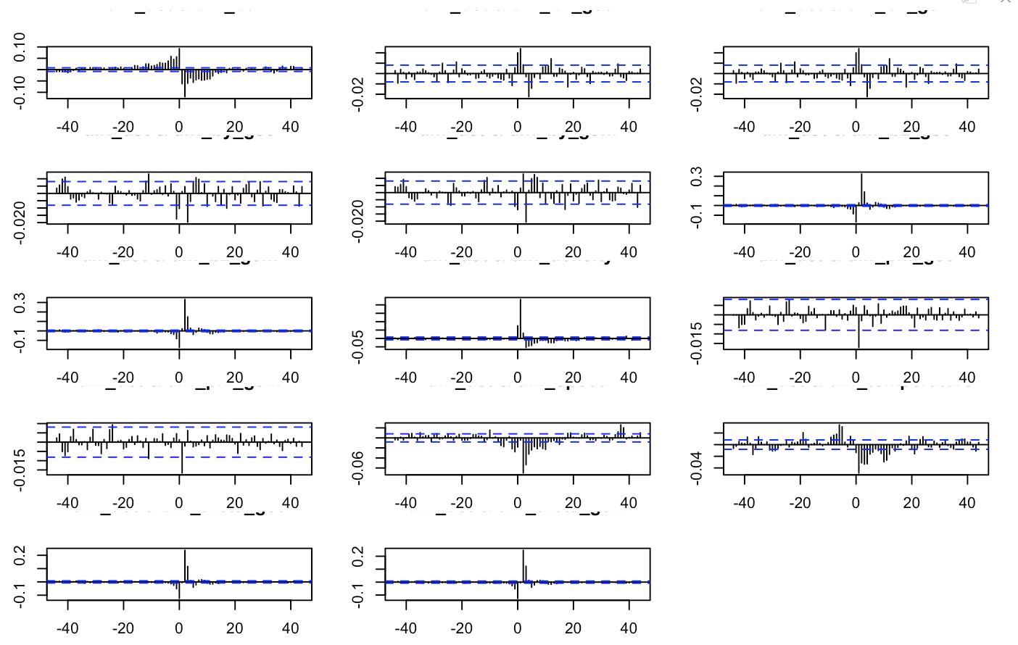
Cross Correlation Plots after Differencing

Slide 15
Cross Correlation Plots Summary after Differencing
Across all plots, the cross-correlations are minimal and generally within the confidence bounds, suggesting no significant lead or lag relationships between the differenced DST time series and the other differenced variables.
This could indicate that the changes in DST do not have a direct or delayed correlation with changes in the other measured variables, at least not within the range of lags presented in these plots.
If these variables were expected to be related, the lack of correlation could suggest that any relationship is not linear or that it might occur at lags not covered by these plots. It's also possible that the differencing process has removed or obscured any relationships by equalizing mean levels and emphasizing transitory fluctuations between successive observations.

Slide 16
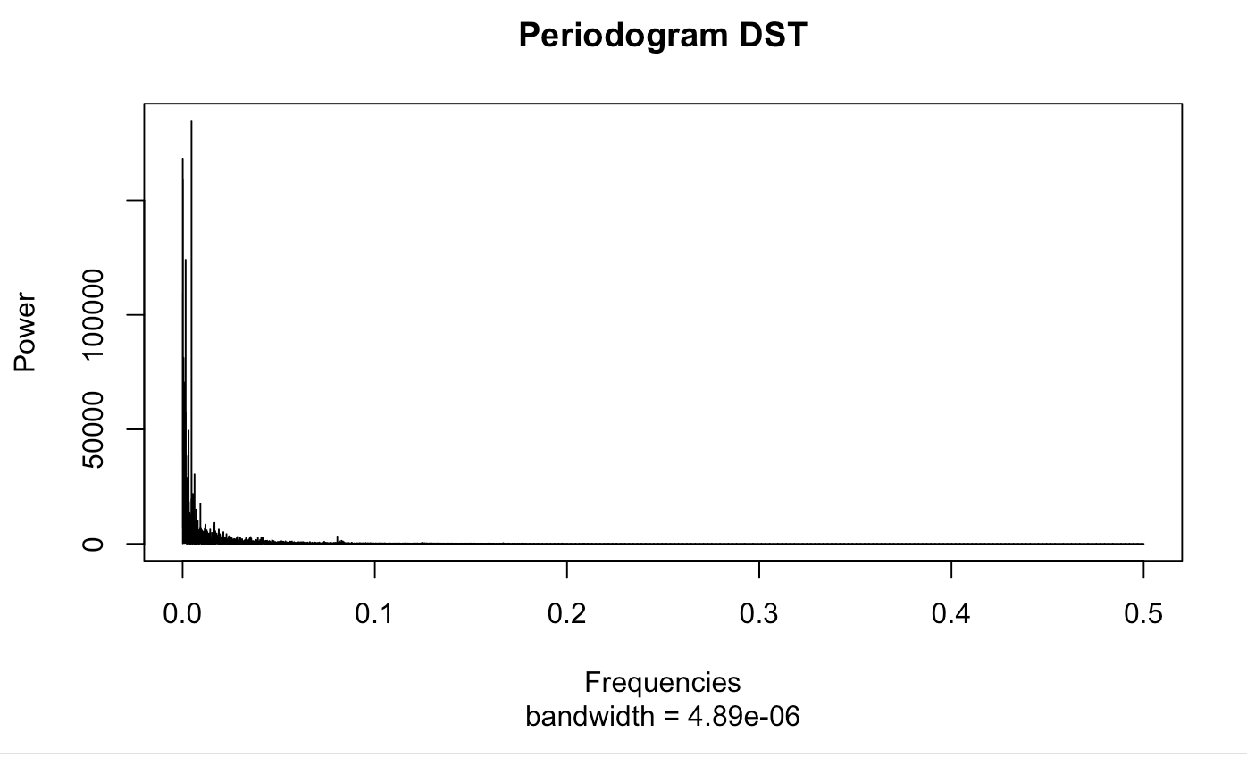
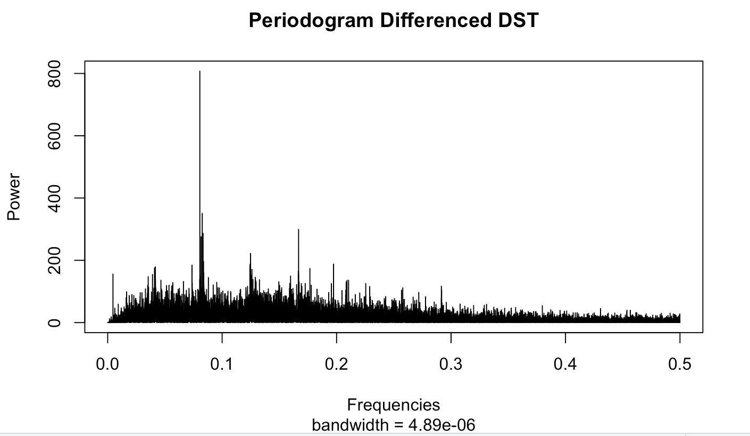
Spectral Analysis
The process of differencing has reduced the dominance of the trend component in the DST data, as evidenced by the decrease in power at the low-frequency range in the periodogram. The presence of smaller peaks in the differenced data suggests that there may be other underlying structures or seasonal effects in the DST index that were not as apparent before differencing. The periodograms provide a clear visual representation of the impact of differencing on the time series data, moving it towards stationarity—a requirement for many time series analysis methods, including ARIMA modeling.

Slide 17
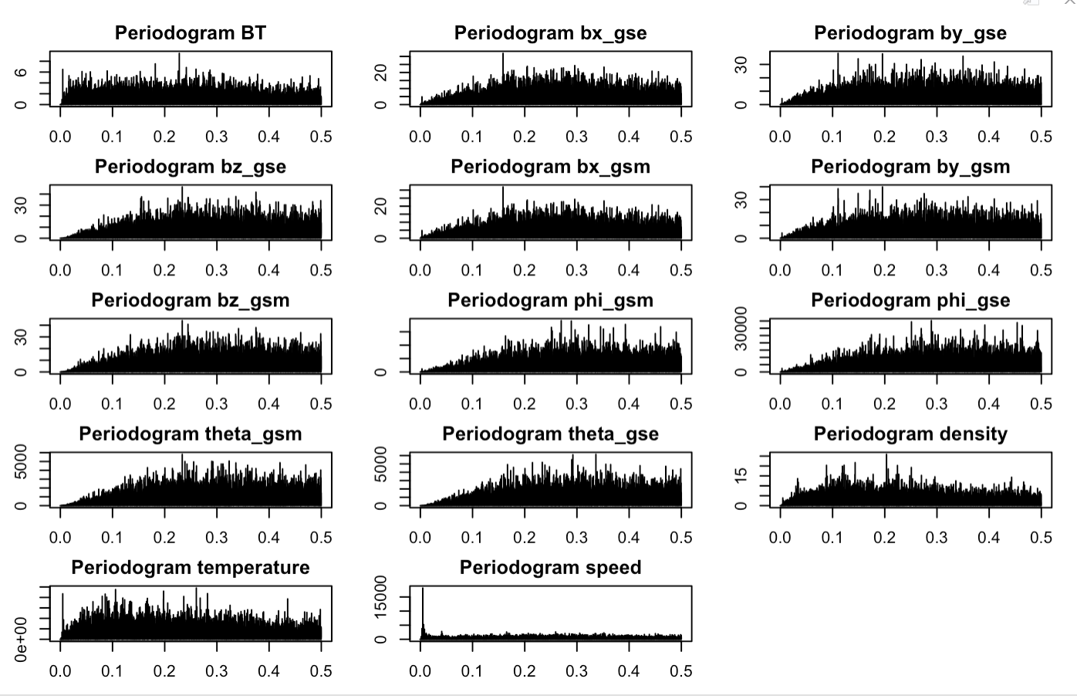

Slide 18
Spectral Analysis Summary
Periodogram BT: The flat spectrum across frequencies suggests that differencing has removed any trend in the total magnetic field strength (BT) data, as no strong periodic components are evident.
Periodogram bx_gse: The lack of distinct peaks implies that differencing has effectively mitigated any non-stationary behavior in the x-component of the magnetic field in GSE coordinates.
Periodogram by_gse: A uniform spread of power indicates that trends or seasonality in the y-component of GSE coordinates have likely been addressed through differencing.
Periodogram bz_gse: The widespread spectral density without dominant frequencies suggests that differencing has neutralized any clear periodicity in the z-component in GSE coordinates.
Periodogram bx_gsm: Similar to the GSE coordinate counterpart, the bx_gsm data after differencing show no significant periodic components.
Periodogram by_gsm: The absence of pronounced peaks in the by_gsm dataset suggests that differencing has removed non-stationary elements, such as trends or seasonality.
Periodogram bz_gsm: A widespread spectral density indicates that differencing has likely achieved stationarity for the z-component in GSM coordinates.
Periodogram phi_gsm: The even spectral density across frequencies implies that differencing has addressed any non-stationary behavior in the azimuthal angle in GSM coordinates.
Periodogram phi_gse: The lack of standout peaks in the phi_gse dataset suggests that differencing has mitigated periodic or seasonal patterns.
Periodogram theta_gsm: The dispersed spectral density for the polar angle in GSM coordinates post-differencing indicates the removal of trends and potential cyclic behavior.
Periodogram theta_gse: An even distribution of power across frequencies for the polar angle in GSE coordinates suggests that differencing has normalized the data.
Periodogram density: The absence of strong periodic signals in the plasma density periodogram suggests that differencing has been effective in creating a stationary time series.
Periodogram speed: The flat spectrum across frequencies for the solar wind speed indicates that differencing has likely removed non-stationary elements from the data.
Periodogram temperature: The widespread spectral density in the temperature data suggests that differencing has neutralized trends and periodicities.

Slide 19
Experimenting with different Linear Models
I created 5 different ARIMA models.
The first model consisted of variables upto 4 lags.
The second model consisted of variables upto 3 lags.
The third model consisted of variables upto 2 lags.
The fourth model consisted of variables upto 2 lags.
The last model, the simple one, consisted of just the variables, no lagged variables.
I also developed a SARIMA model whose performance was similar to the first ARIMA model.

Slide 20
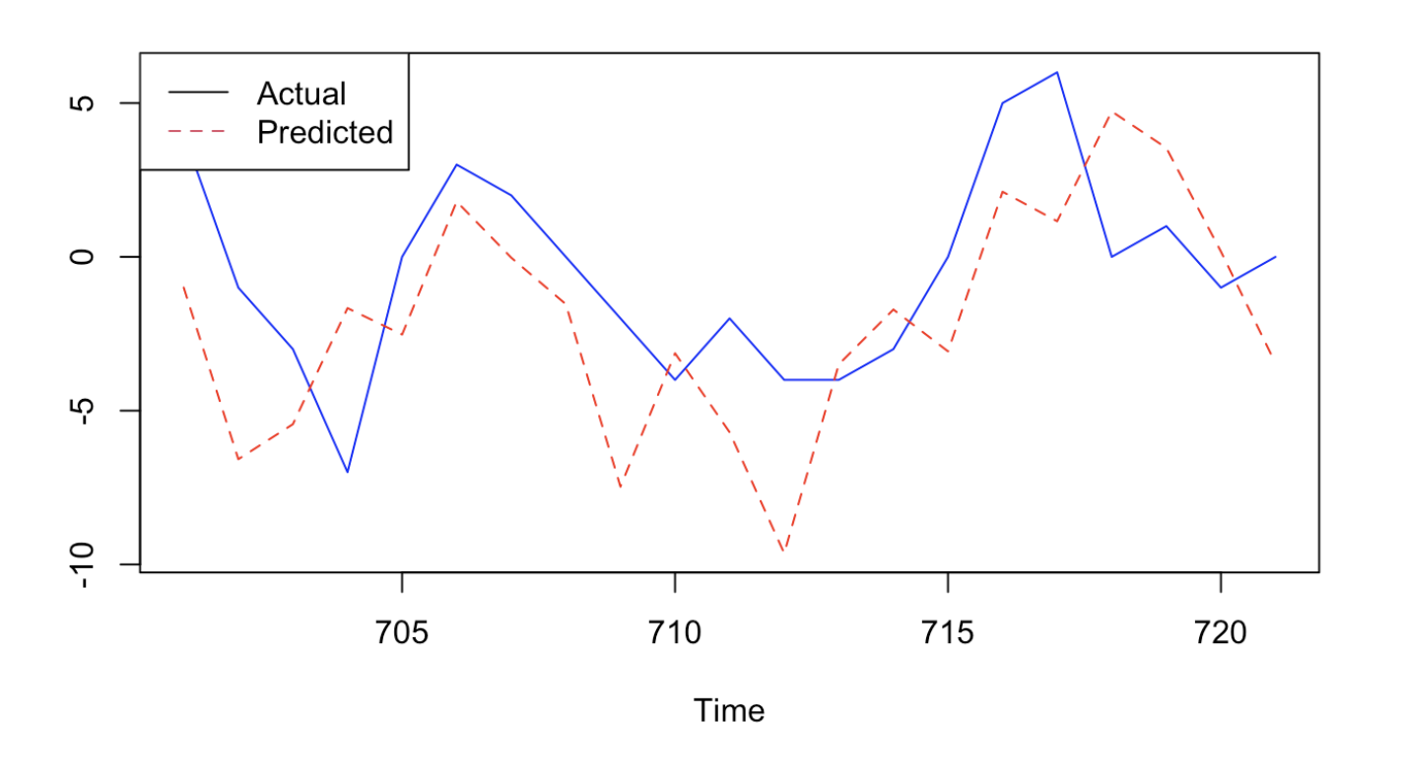
Best Performing Model
The ARIMA model with upto 4 lagged variables is the best model in terms of prediction because it has the lowest AIC score of 3312.78.
I am choosing AIC over BIC score because AIC is more suitable for short term forecasting (as in the case of DST, is hourly).

Slide 21
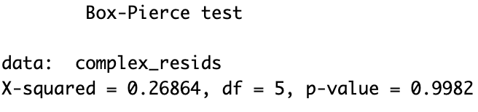
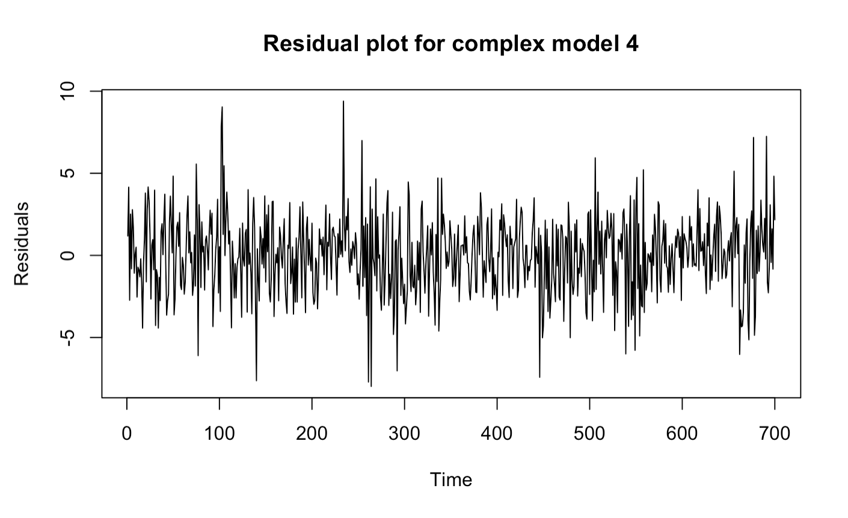
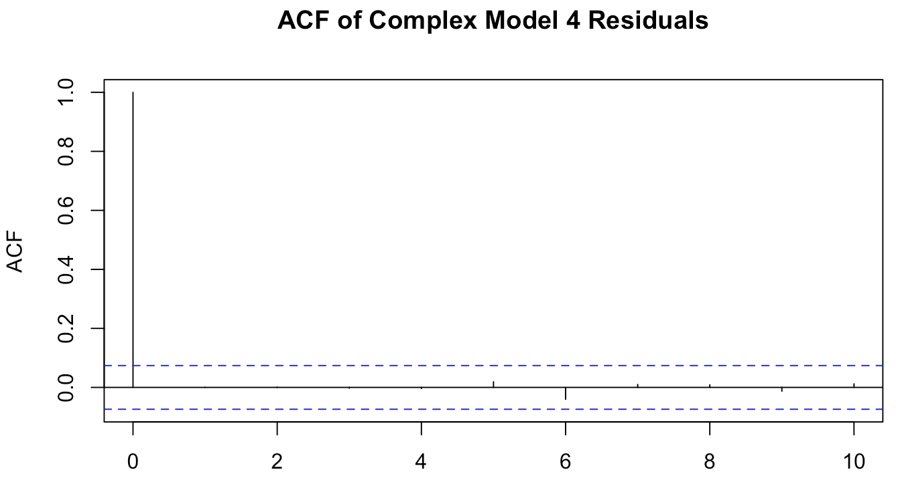
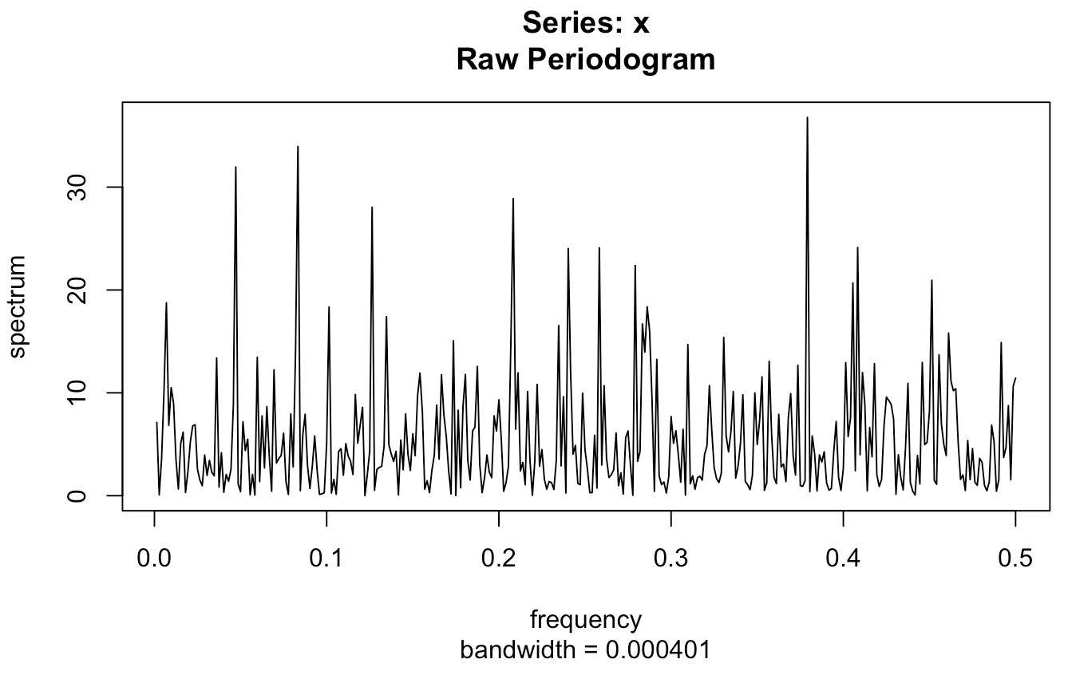
The Box-Pierce test results suggest that there is no significant autocorrelation in the residuals at lags up to 5, as the p-value is high (0.9982).This means we fail to reject the null hypothesis of no autocorrelation in the residuals, which is what we want in a well-fitting model.
The residuals of the model fluctuate around zero, which is generally a good sign. However, there are some large spikes, indicating possible outliers or moments of high volatility not captured by the model. It follows a random walk and they are white noise.
The ACF plot shows that autocorrelations are within the confidence bounds for most lags, suggesting that there is no significant autocorrelation in the residuals. This indicates that the model has captured the time series' structure well, at least in terms of linear relationships.
The absence of strong peaks suggests that no single frequency dominates the residuals, which is another indicator of a good model fit.

Slide 22
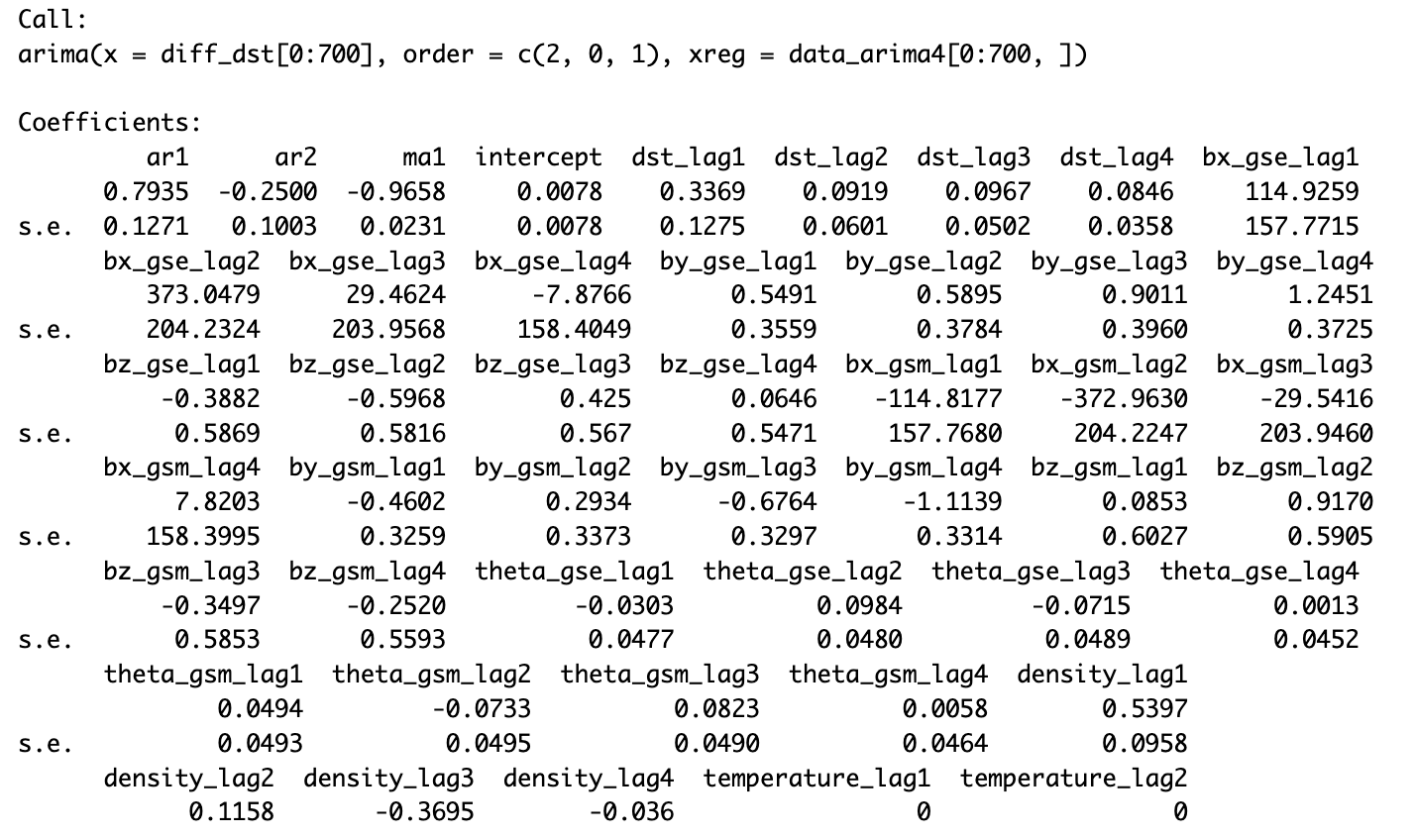
The first AR term (ar1) is significant with a coefficient of 0.7935 and a standard error of 0.1271, indicating a strong positive correlation with the first lag of the differenced series.
The second AR term (ar2) is also significant but negative with a coefficient of -0.2500 and a standard error of 0.1003, suggesting a partial corrective effect from the second lag.The MA term (ma1) is highly significant with a coefficient of -0.9658 and a small standard error, indicating the model accounts for a substantial amount of noise from the previous term.
Among the external regressors, certain lags seem to have significant coefficients, such as bx_gse_lag2, by_gse_lag3, by_gsm_lag4, theta_gsm_lag2, and density_lag1.
The significance of the AR and MA terms alongside some external regressors suggests a relatively good fit to the historical data.

Slide 23
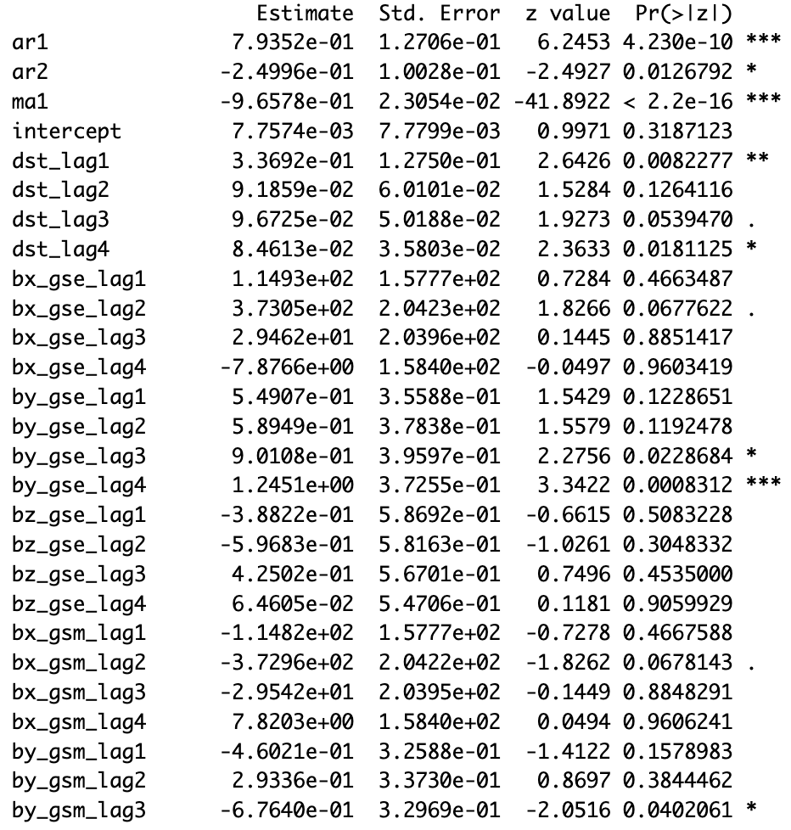
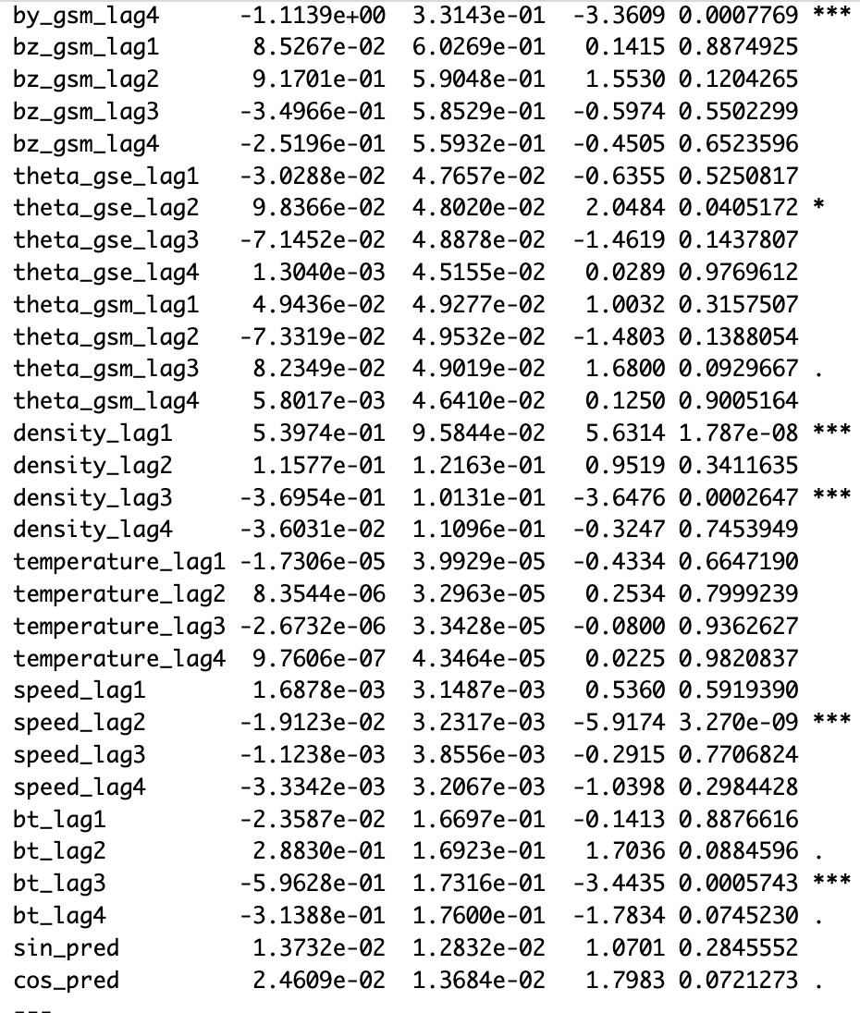
9.0108e-01

Slide 24
Conclusion from Modeling Analysis
9.0108e-01
The ARIMA model with external regressors, which included lagged values of solar wind variables and DST itself, showed that certain past values are indeed relevant in predicting DST. The significance of these lags indicates some form of dependency, supporting the idea that DST is influenced by past solar wind conditions and its own past values, though this influence may be more nuanced than a straightforward day-to-day relationship.
The model diagnostics, including residual checks and the Box-Pierce test, suggest that the model captured the underlying process adequately, with residuals behaving as white noise, indicating that there is no obvious structure left in the residuals that the model has failed to capture.

Slide 25
Conclusion for Hypothesis
9.0108e-01
DST follows a seasonal trend over the years.
The initial periodogram of the DST data before differencing suggested the presence of a strong low-frequency component, which could indicate a seasonal trend or a long-term pattern. However, after differencing, this prominent peak was removed, suggesting that any seasonality was effectively addressed by the differencing process. While this supports the hypothesis of seasonality, the absence of significant seasonal parameters in the final ARIMA model could mean that the seasonality is not a dominant feature after differencing or may not be periodic within the range of the ARIMA model's lags.
DST is influenced by the lagged values of features associated with solar winds.
The cross-correlation functions between differenced DST and the differenced solar wind variables did not reveal strong correlations at various lags. This suggests that the linear relationship between daily changes in DST and the daily changes in the solar wind variables may not be significant. However, the ARIMA model's coefficients for certain lags of solar wind variables were significant, indicating some predictive power. The relationship may be complex and not entirely linear, or it may manifest over different lags than those initially considered.

Slide 26
Conclusion for Hypothesis
9.0108e-01
DST depends on the previous day’s dst.
The ACF plot for the differenced DST data indicated that the autocorrelations for most lags were within the confidence bounds, suggesting no significant autocorrelation after differencing. This would imply that the differenced DST is not dependent on its immediate past values once it has been made stationary. Nonetheless, the ARIMA model coefficients for lagged DST values (dst_lag1, dst_lag2, etc.) were significant, pointing to some dependency, albeit likely of a more complex nature than direct day-to-day influence.
The findings are somewhat mixed with regard to the initial hypotheses. While there is evidence supporting the impact of past solar wind conditions on DST and some indication of seasonality and autocorrelation, the relationships are not straightforward. They may involve more complex dynamics than simple linear dependencies, requiring a nuanced modeling approach. Further refinement of the model could include examining non-linear relationships, considering additional or different lags, and incorporating other potential predictors that might help in understanding the DST index variations better. Other techniques such as Machine Learning or Long Short Term Memory models would be helpful in providing better forecasts.

